Slide 1
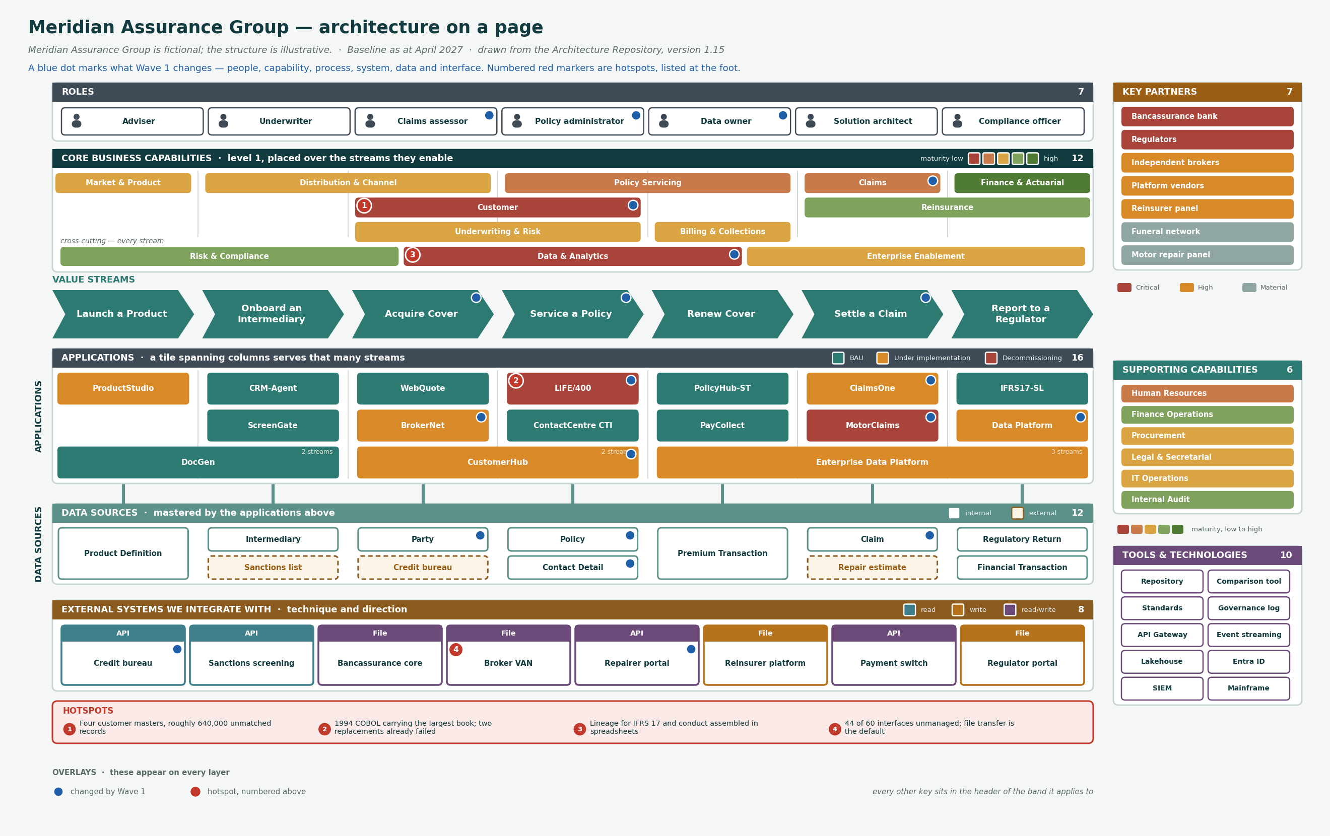

Slide 2
ONE PAGE
How to read it
The streams are the spine. Capabilities sit over the streams they enable, applications and data beneath the streams they serve.
Roles
top strip
7
Who performs the capabilities.
Core capabilities
aligned to streams
12
Each sits over the streams it enables. Three are cross-cutting and sit on their own row. Coloured by maturity.
Value streams
chevrons
7
In lifecycle order: build, sign, sell, service, renew, pay, report. Capabilities sit above, applications and data below.
Applications
in lanes under the streams
16
Coloured by lifecycle. A tile stretched across columns serves that many value streams — CustomerHub two, DocGen two, Enterprise Data Platform three.
Data sources
under applications
11
Solid outline is internal. Dashed amber is external — credit bureau, sanctions list, repair estimate.
External systems
bottom band
8
Each carries its integration technique — API or file — and is coloured by direction: read, write, or read/write.
Key partners
right rail
7
Ordered and coloured by importance. Regulators and the bancassurance bank are Critical.
Supporting capabilities
right rail
6
HR, finance operations, procurement, legal, IT and audit, on the same maturity scale.
Tools and technologies
right rail, foot
10
Architecture tooling and the platform technologies underneath the estate.
Change overlay
blue dots, every layer
21
What Wave 1 changes, across every layer: 3 roles, 3 capabilities, 3 streams, 6 applications, 4 data entities, 2 interfaces.
Hotspots
numbered red markers
4
The four places that actually hurt, listed at the foot of the page.
Every element is read from the Architecture Repository at build. If the repository changes, the page changes — it is not a drawing that has to be remembered.

Slide 3
HONEST LIMITS
What one page cannot do
A single view of an entire architecture is useful for orientation and misleading for anything else. Three limits worth stating before it gets used.
It shows membership, not relationships
You can see that 26 applications and 24 data entities exist. You cannot see which application masters which entity — that is 1,718 relationship instances and no single page holds them.
Use the metamodel reports. RPT05 gives application-to-data; RPT03 gives the capability rollup.
It shows a chosen subset, not the estate
Sixteen applications of 26, eleven data entities of 24, and twelve capabilities standing for 556. Everything here was selected to fit the streams shown.
Use the repository for completeness. This page is for orientation and briefing, not for scoping.
It shows the estate, not its condition
Nothing on the page distinguishes LIFE/400 from the API Gateway, or a tested recovery from an untested one. Every box looks equally healthy.
Use the heat-mapped capability view and the resilience tiering matrix. Both exist precisely because this page cannot carry condition.
The right-hand column is where to go instead. A one-pager that does not say what it cannot answer gets used for decisions it cannot support.

